Slide 1
Basic Ιllumination model

Slide 2
Light Sources
Light emitting sources
Light reflecting sources

Slide 3



Light emitting Sources
The sun
Candle Flames
Electric Light Bulbs

Slide 4
Light emitting sources
Point source
Distributed light source

Slide 5
Point Light Sources
emits light equally in all directions from a single point
The direction to the light from a point on a surface differs for different points
l
p

Slide 6
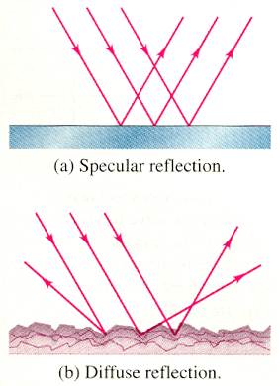
Reflection

Slide 7
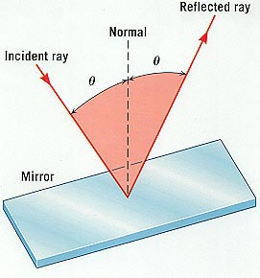

Slide 8
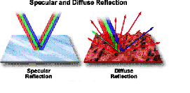

Slide 9
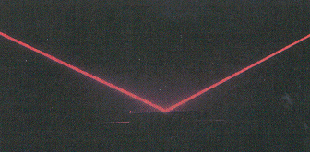
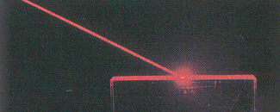
Specular
Specular reflection diffuse reflection

Slide 10
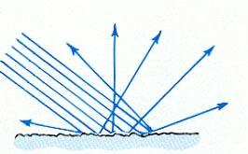
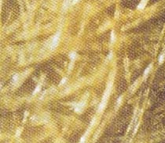
Diffuse Reflection
Rough surfaces consist of a large number of different specularly-reflecting planes. | Visible light reflects diffusely from paper.

Slide 11
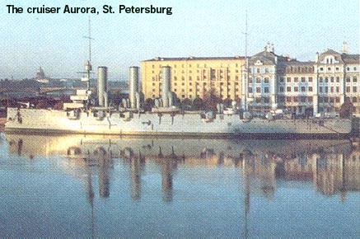
When water is still ,the reflection is specular.
When the water flows the image blurs.

Slide 12
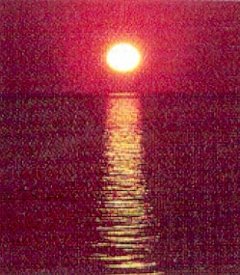
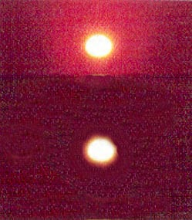
Specular versus Diffuse Reflection
 | What kind of reflections account for the column of light reflected off the water? What would we see on the water if it were perfectly flat, unmoving?

Slide 13
Basic illumination models

Slide 14
Illumination model
Model the interaction of light with the surface
Describes properties of light.
Lighting

Slide 15
Illumination models
Local Illumination = direct illumination - considers light traveling directly from source to surface
Global Illumination = indirect illumination - takes into account reflection of light from other surfaces

Slide 16
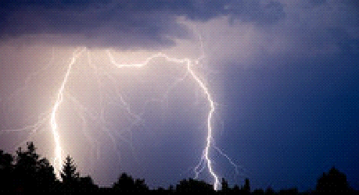
Ambient light

Slide 17
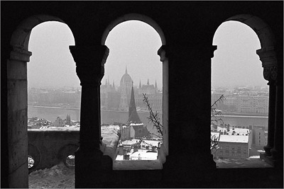
Ambient Light

Slide 18
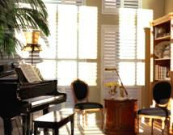
Room with pleasant ambient light

Slide 19
Ambient Light
Reflected intensity , I = ka Ia
where Ia ->intensity of ambient light
ka -> = reflection coefficient

Slide 20
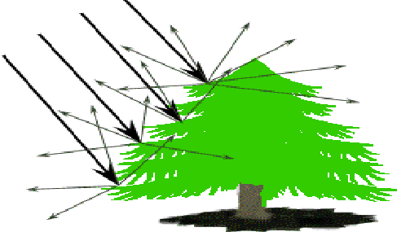
Diffuse reflection

Slide 21
Diffuse Reflection
independent of viewing position
When surface is exposed only to ambient light ,the intensity of the diffuse reflection at any point is given by
Iambdiff = Kd Ia
Kd -> Coefficient of diffused reflection.
Ia -> Intensity of ambient light.

Slide 22
When surface is exposed only to point light ,the intensity of the diffuse reflection at any point is given by
Ιl,diff = Kd ll cos θ
Kd -> Coefficient of diffused reflection.
Ιl -> Intensity of point light.

Slide 23
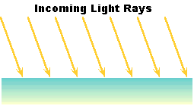
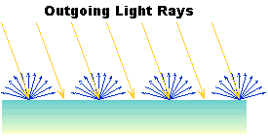
Ideal Diffuse Reflection or Lambertian Reflection

Slide 24

Lambert’s cosine law
Intensity of the reflected
light depends on the angle
of illumination.
Cos θ = Ν.L
Ν −> Unit normal vector to a
surface.
L -> Unit direction vector to the
point light source from a position
on the surface.

Slide 25
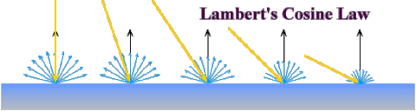

Slide 26
Total diffuse reflection
Idiff = Ka Ia + Kd Ιl (N.L)

Slide 27
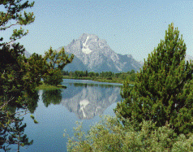
Specular reflection

Slide 28
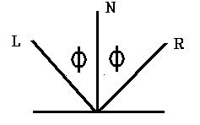
Specular reflection
Mirror like reflection
view dependent
Specular highlight
For an ideal reflector, angle of incidence = angle of specular reflection.

Slide 29
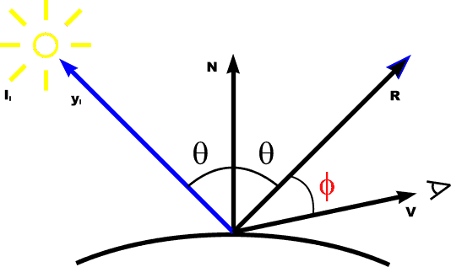
Specular reflection
I spec = W(θ) Ιl cos ns

Slide 30
Warn model
Simulates studio lighting effects by controlling light intensity in different directions
Spot lighting is simulated in warn model

Slide 31
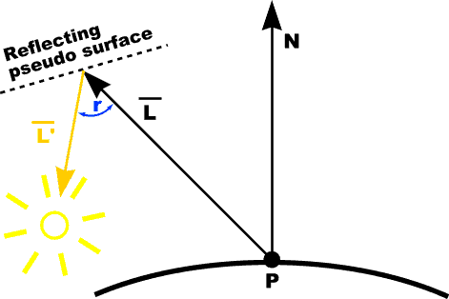
Warn model
control light direction using reflecting surface (only specular)

Slide 32
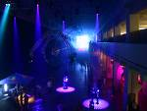
Spotlighting

Slide 33

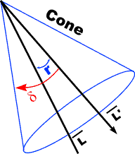
Warn model
Spotlights are used to control the amount of light emitted within a cone with apex at a point source.

Slide 34
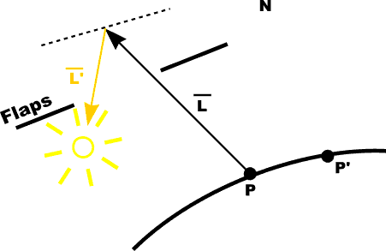
Warn model
Flaps are used to control the amount of light emitted by a source in various directions

Slide 35
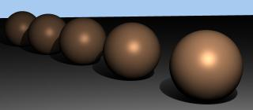
Intensity attenuation

Slide 36
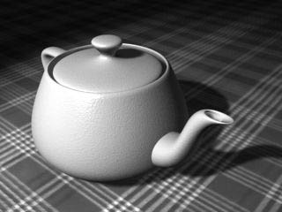
Intensity attenuation

Slide 37

RGB

Slide 38

RGB

Slide 39
Summary

Slide 40
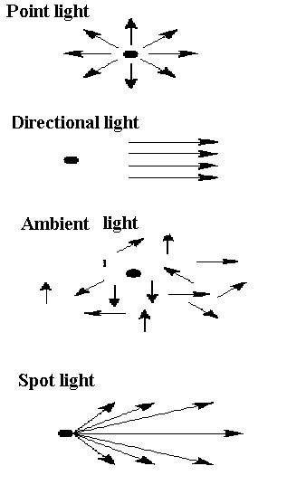

Slide 41
Reflection
Diffuse reflection
Specular reflection

Slide 42
Illumination models

Slide 43

Ambient lighting

Slide 44
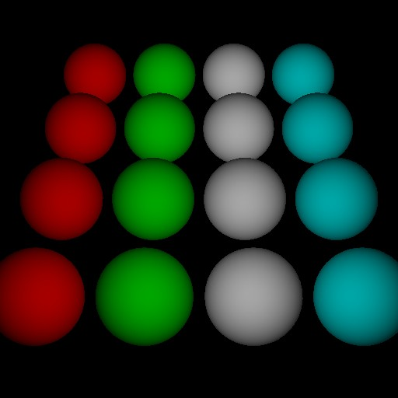
Diffuse reflections

Slide 45
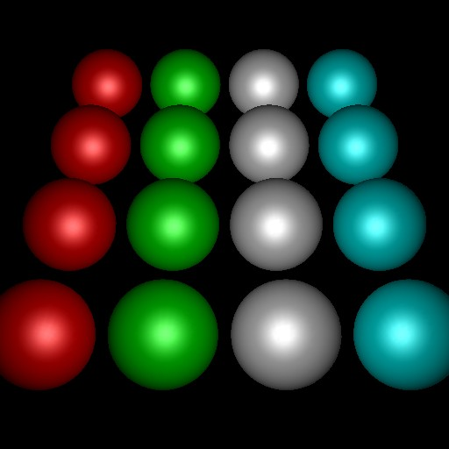
Specular reflections
mirror like reflections that add highlights to a shiny object

Slide 46
The END

